Slide 1
Smart Scanners for Cards/Documents
Ivy Luxen Xie

Slide 2
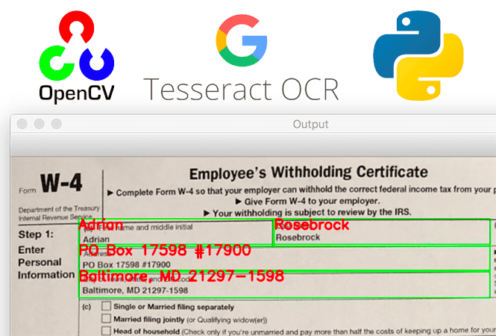
In this project, I will design two smart scanners upon which several tasks could be performed. One scanner is built for scanning bank cards, and the other scanner is used to scan standardized test answer sheets.

Slide 3
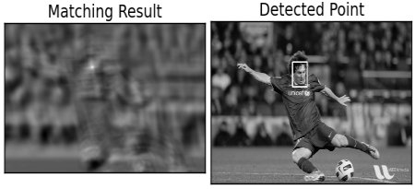
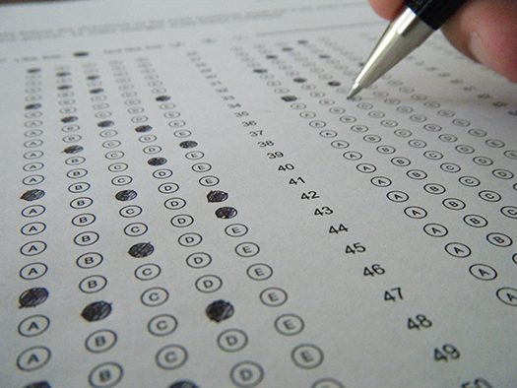
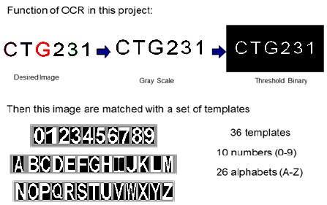
CIS581 Extra Project Highlights: OMR and OCR-A Template Matching

Slide 4
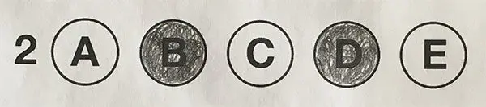
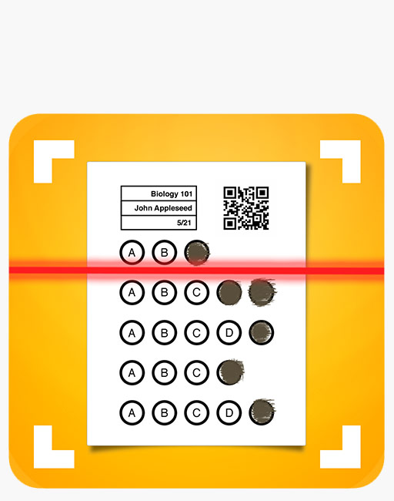
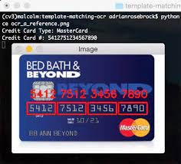
2. Main goal: capture, analyze and display information on the surface of input image

Slide 5



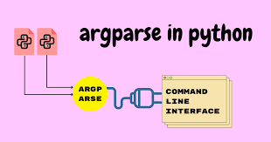

3. Libraries for Use: OpenCV, Numpy, Matplotlib,
Imutils and Argparse

Slide 6
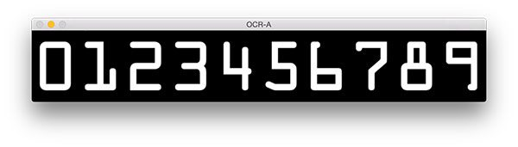
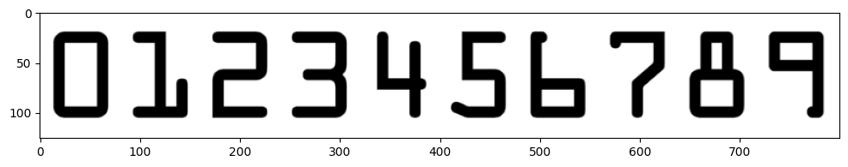
4. Reference Images for OCR-A Template Matching(grayscale and threshold/invert it)

Slide 7
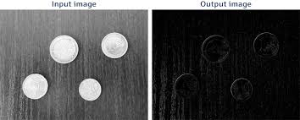
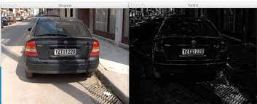
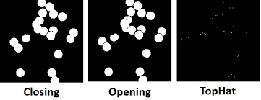
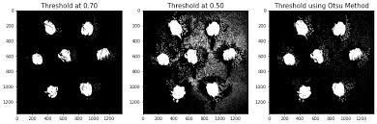
5. Whitehat operation reveals light region against a dark background;
Otsu Segmentation reveals white region against a black background

Slide 8
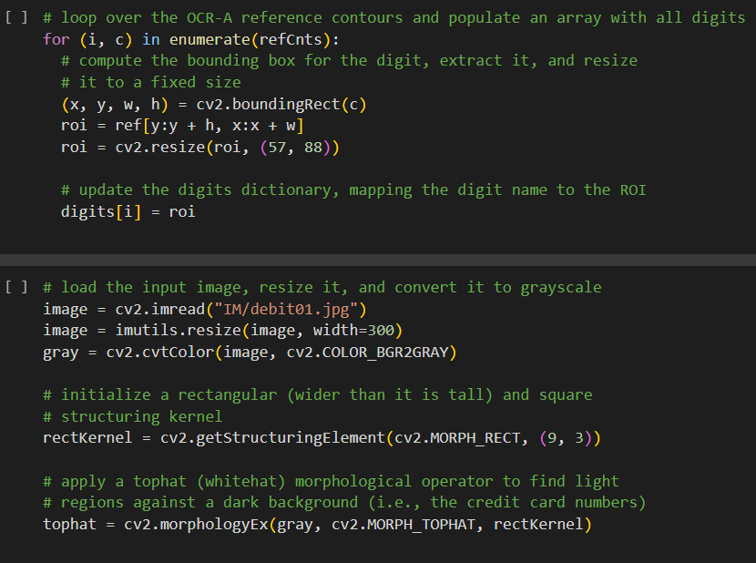
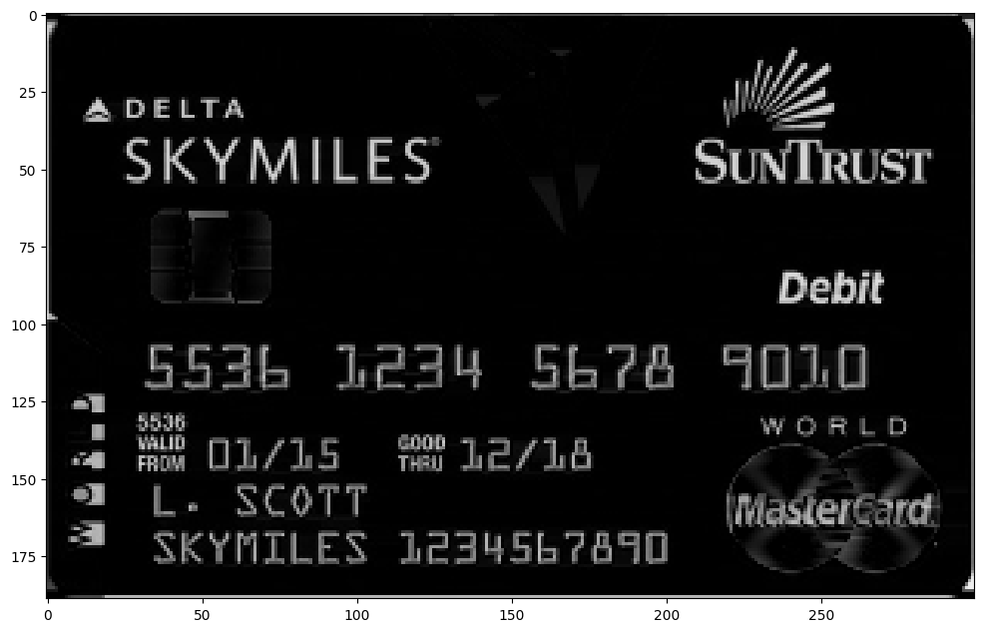
The Whitehat operation reveals light regions against a dark background
Resulted image of bank card

Slide 9
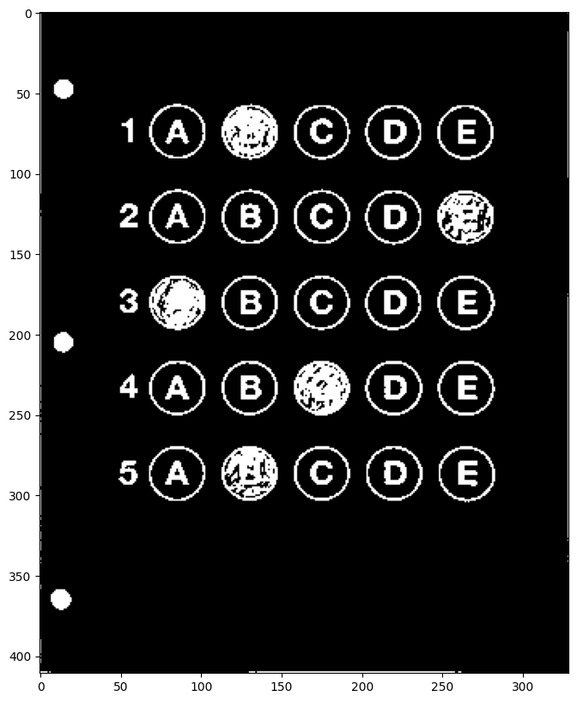
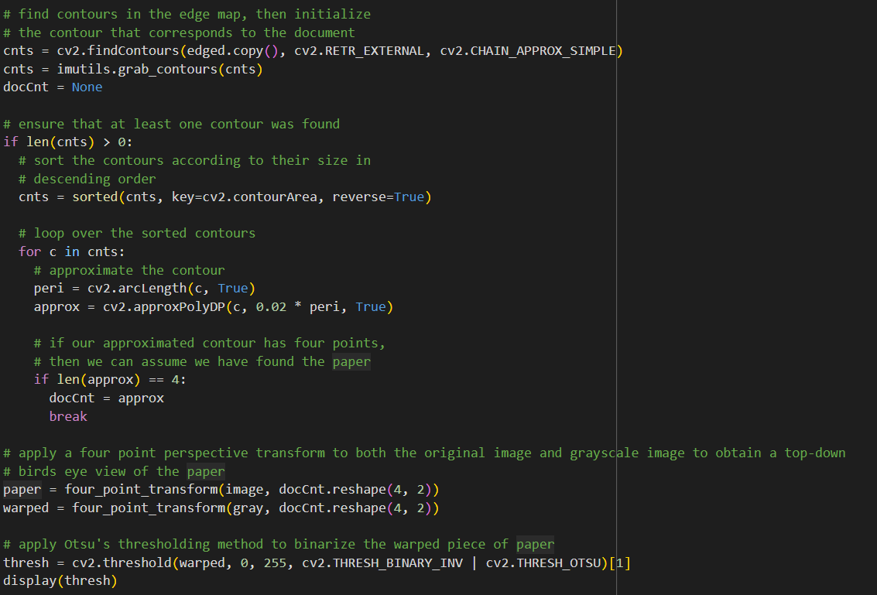
Apply Otsu's thresholding method to binarize the warped piece of paper
Resulted Image

Slide 10
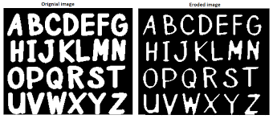

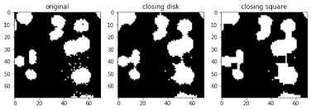
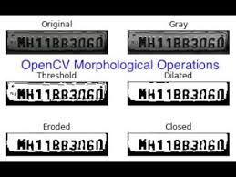
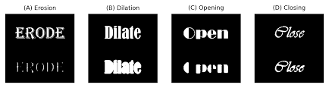
6. Morphological Operations

Slide 11
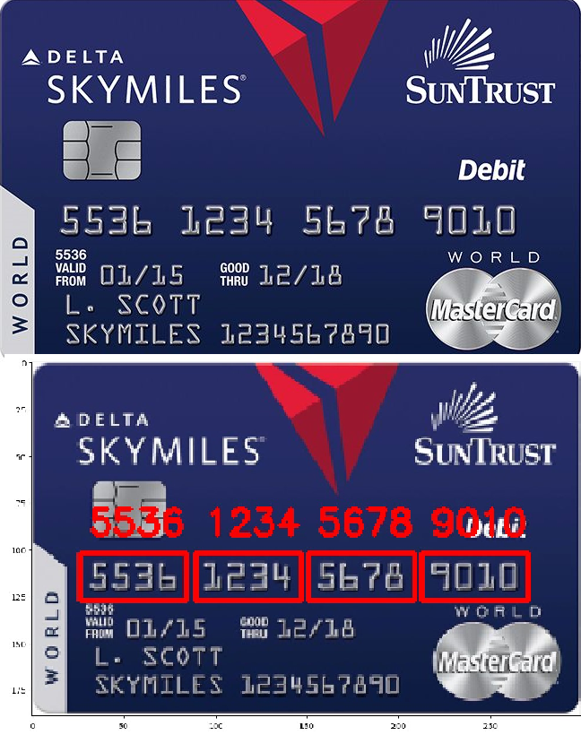
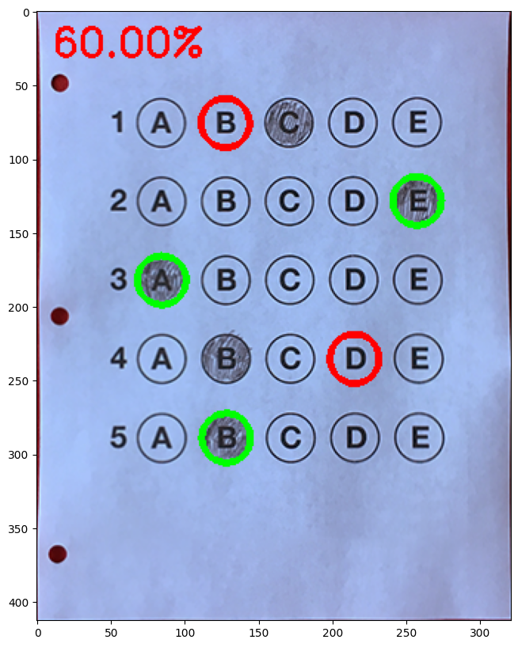
Porject Summary
Goal: Capture and analyze relevant information on the surface of documents
Use template matching as a form of OCR to help create a solution to automatically recognize bank cards and extract the associated bank card digits from images.
Train a model to accurately recognize and grade the STA answer sheets, making it useful for automating multiple-choice test evaluation.

Slide 12
Related Works
What is OMR(Optical Mark Recognition)?
https://remarksoftware.com/omr-technology/what-is-omr-optical-mark-recognition/
How to Extract Information from Documents: Template Matching
https://aicha-fatrah.medium.com/how-to-extract-information-from-documents-template-matching-e0540ae79599
Morphological Transformations Tutorials
https://docs.opencv.org/4.x/d9/d61/tutorial_py_morphological_ops.html
Contour Tracing Algorithm
https://www.imageprocessingplace.com/downloads_V3/root_downloads/tutorials/contour_tracing_Abeer_George_Ghuneim/intro.html
Brief Study of Image Thresholding Algorithms
https://www.analyticsvidhya.com/blog/2022/07/a-brief-study-of-image-thresholding-algorithms/

Slide 13
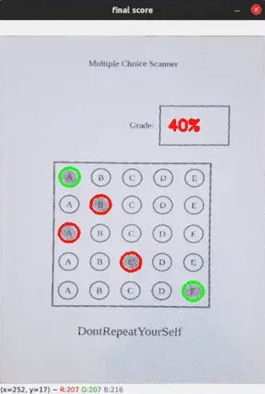
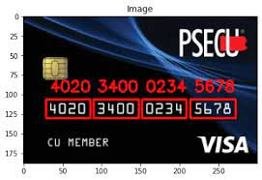
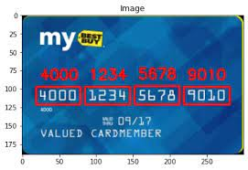
Aimed Results after Scanning
Results of the scanned card and test answer sheet:

Slide 14
Thank You

